Slide 1

Systematic and Technologic Automated Restaurant System (STARS)
Prepared by
Fong, William
Mahbub, Saba
Mahbub, Safa
Placencia, Juan
October 31, 2016

Slide 2
STARS
STARS is a software model that will allow restaurants to become fully automated.
Our goal is to create a reusable software for any restaurant where all you have to do is upload a recipe for it to run.
This way, we limit unnecessary order confusion.

Slide 3
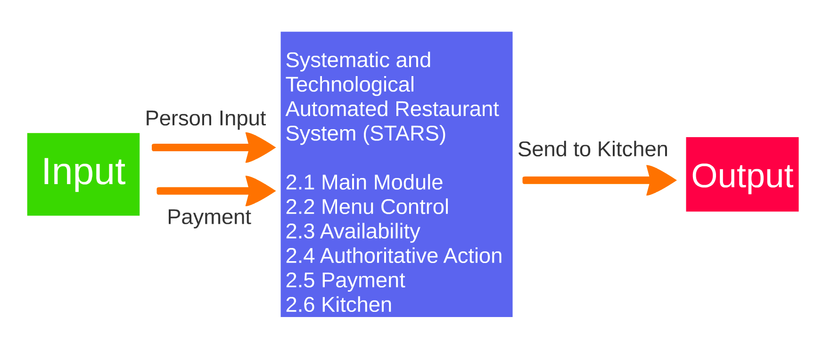
DFD 0

Slide 4
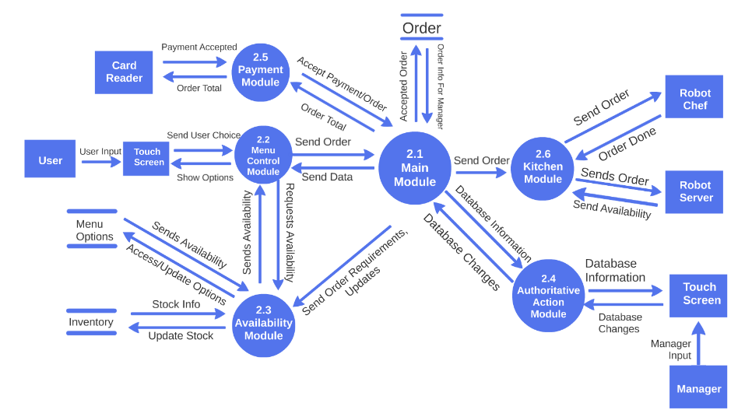
DFD 1

Slide 5
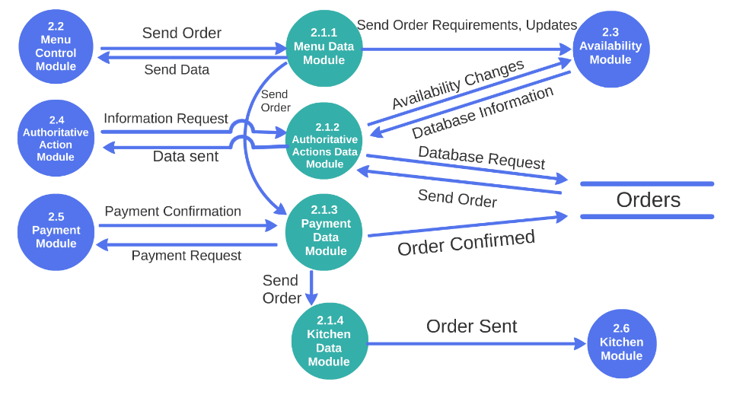
DFD 2.1: Main Module

Slide 6

The Main Module (MM) is the central processing module that links the other modules together to keep information flow smooth and efficient.
2.1 Main Module
Notes:
The MM is charged with taking requests and gives back the appropriate response. The MM will also take transaction conformations and send them to a database and kitchen module. The MM contains sub modules to help it process all the data.

Slide 7
DFD 2.1: Main Module

Slide 8
2.1.1 Menu Data Module
2.1 Main Module
The Menu Data Module (MDM) is responsible for sending data from the Main Module to other modules to keep data flow consistent. The MDM will receive an order and send it to the Availability Module to check if the order can be made. Once the order is confirmed, it gets sent to the Payment Data Module.

Slide 9
DFD 2.1: Main Module

Slide 10

2.1.2 Authoritative Actions Data Module
2.1 Main Module
The Authoritative Actions Data Module (AADM) is in charge of giving the Authoritative Actions Module database information so the user can make the necessary changes or keep track on what’s going on. The AADM will get a request from the Authoritative Actions Module, and then it acquires that information for the Authoritative Actions Module. If ordered, the AADM can make changes in the Availability Module.

Slide 11
DFD 2.1: Main Module

Slide 12

2.1.3 Payment Data Module
2.1 Main Module
The Payment Data Module (PDM) makes sure the confirmed orders are paid for. The PDM gets an order from the MDM then sends it to the PM to get paid for. Once payment is confirmed, the order gets stored in the orders database and gets send to the Kitchen Data Module.

Slide 13
DFD 2.1: Main Module

Slide 14

2.1.4 Kitchen Data Module
2.1 Main Module
The Kitchen Data Module (KDM) takes the confirmed order from the PDM and sends it to the Kitchen Module.

Slide 15
DFD 1

Slide 16
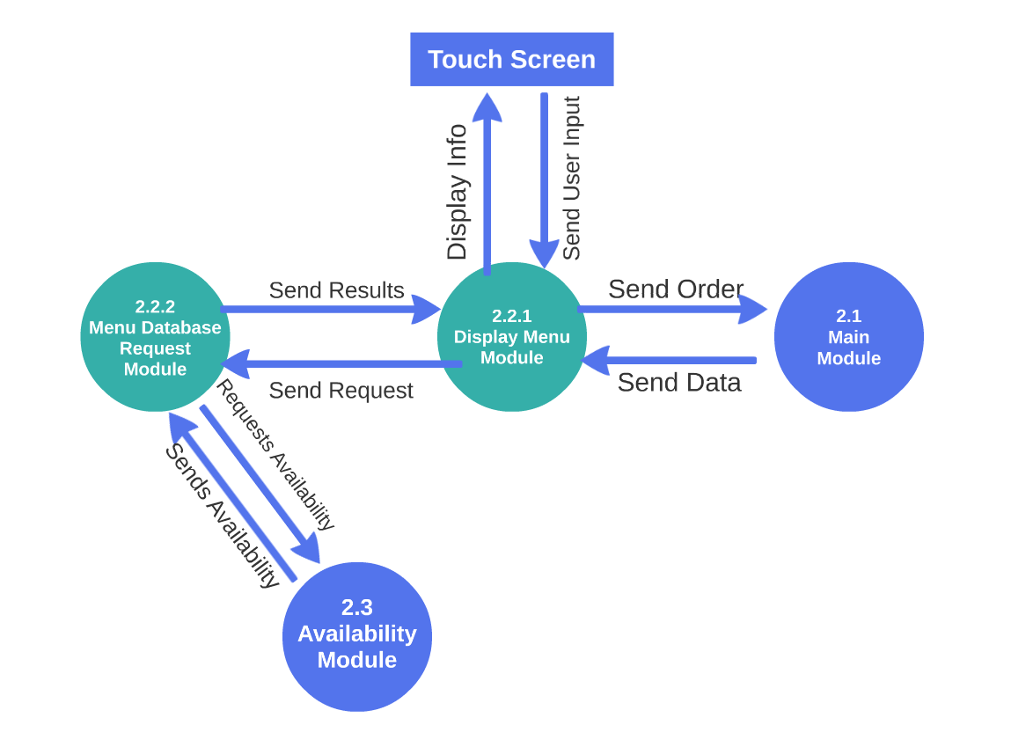
DFD 2.2: Menu Control Module

Slide 17
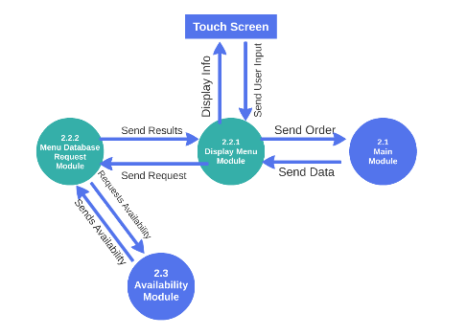
The Menu Control Module (MCM) connects the user to the program through a touch screen.
2.2: Menu Control Module
Notes:
The MCM will receive input from the user and output information to the user through the touch screen. It will also send the order to the MM once the user finalizes the order. The MM will send various data to the MCM such as any status messages, errors, etc.

Slide 18
DFD 2.2: Menu Control Module

Slide 19
Module 2.2.1: Display Menu Module
2.2: Menu Control Module
The Display Menu Module (DMM) takes input from the user through the touch screen and also displays the necessary information. The DMM sends a request to the Menu Database Request Module whenever the user is ordering to get the menu items that are available.
After it takes the order from the user, it sends the completed order to the MM.

Slide 20
DFD 2.2: Menu Control Module

Slide 21

Module 2.2.2: Menu Database Request Module
2.2: Menu Control Module
The Menu Database Request Module (MDRM) is used to request for information regarding the availability of items on the menu.
The MDRM takes a request from the DMM to request information from the Availability Module. It sends the request and receives back the results of the available items to send back to the DMM.

Slide 22
DFD 1

Slide 23
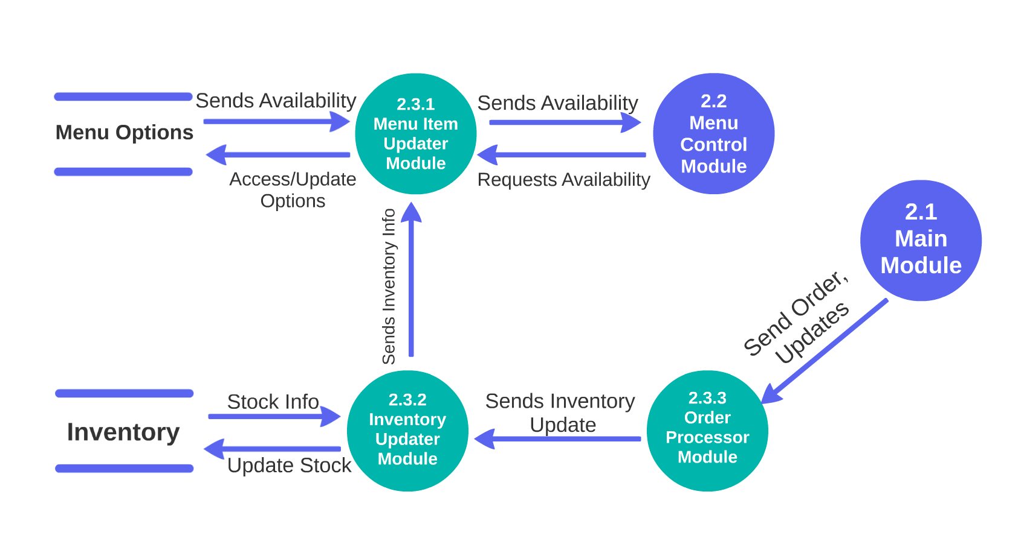
DFD 2.3: Availability Module

Slide 24
The Availability Module (AM) will provide and update information about the current inventory of the ingredients and of the menu items.
2.3: Availability Module
Notes:
Every time an order is successfully placed, the AM will receive data from the main module to update the new inventory stock. The AM will also read the availability from the inventory and update which items on the menu are available to be ordered and send it to the MCM to be displayed.

Slide 25
DFD 2.3: Availability Module

Slide 26
2.3.1 Menu Item Updater Module
2.3: Availability Module
The Menu Item Updater Module (MIUM) is used to process information about the availability of the menu items.
The MIUM receives data from the Menu Options Database, MCM, and the Inventory Updater Module to update the Menu Options database accordingly.

Slide 27
DFD 2.3: Availability Module

Slide 28
2.3.2 Inventory Updater Module
2.3: Availability Module
The Inventory Updater Module (IUM) is used to process information about the availability of the inventory.
The IUM takes information from the Order Processor Module and the Inventory database. The IUM sends the inventory information to the MIUM.

Slide 29
DFD 2.3: Availability Module

Slide 30
2.3.3 Order Processor Module
2.3: Availability Module
The Order Processor Module (OPM) processes information about completed orders and any updates needed to be made.
The OPM takes in the order or updates from the MM and sends that information to the IUM to update the database.

Slide 31
DFD 1

Slide 32
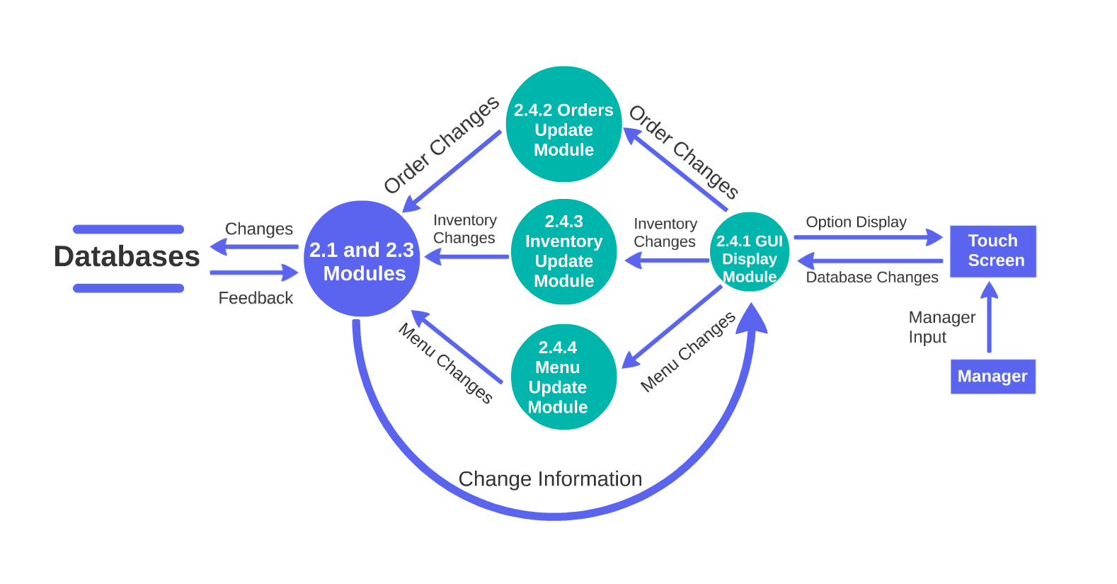
DFD 2.4: Authoritative Action Module

Slide 33
The Authoritative Action Module (AAM) is used when a manager needs to read information/change information within the three databases.
2.4 Authoritative Action Module

Slide 34
DFD 2.4: Authoritative Action Module

Slide 35
2.4.1 GUI Display Module
2.4 Authoritative Action Module
The GUI Display Module (GDM) validates that the managers is authorized to make changes to the database. Then the GUI will give the manager the option to change the database.

Slide 36
DFD 2.4: Authoritative Action Module

Slide 37
2.4.2 Orders Update Module
2.4 Authoritative Action Module
The Orders Update Module (OUM) deals with changes in the Orders database. The manager is only able to append information to the order, not directly change the names, amount, confirmation, or complaints.

Slide 38
DFD 2.4: Authoritative Action Module

Slide 39
2.4.3 Inventory Change Module
2.4 Authoritative Action Module
The Inventory Change Module (ICM) deals with changes in Inventory database. The manager is then able to sort through the items and put in value changes. The manager is able to add items, delete items, and change quantity in this Module.

Slide 40
DFD 2.4: Authoritative Action Module

Slide 41
2.4.4 Menu Update Module
2.4 Authoritative Action Module
The Menu Update Module (MUM) deals with changes in the Menu Options database. The manager is then able to add menu items.

Slide 42
DFD 1

Slide 43
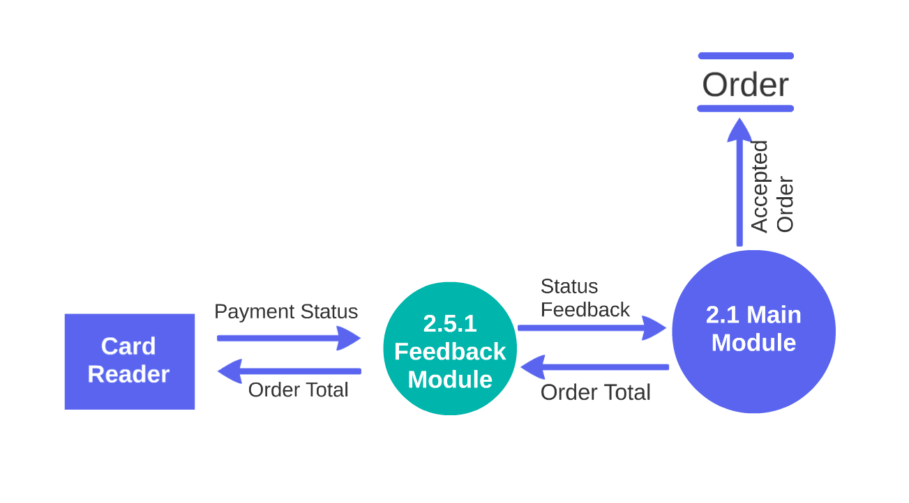
DFD 2.5: Payment Module

Slide 44
The Payment Module (PM) handles payment and confirmation/feedback aspect of STARS.
2.5 Payment Module
2.5 Payment Module
Notes:
The module will take approved orders (orders with confirmed payments) and will then distribute the information to the external Robot Chefs (RC) and external Robot Server (RS). It is noted that the RC and RS are both external devices and as such does not interact with the software much. The only data retrieved by the KM is when the RC has finished cooking their order and which RS are available to serve.

Slide 45
2.5 Payment Module (PM)
The Payment Module (PM) handles the all the payment operations for the restaurant.
Once the user has selected that they are done ordering from the User GUI/UI, the total order shall be sent to be processed by the module.
The PM shall validate that the Orders are okay, and send the payment amount to an external card reader.
The external card reader is not part of our program. The only data PM retrieves from the card reader is Payment approval or decline.
2.5 Payment Module

Slide 46
DFD 1

Slide 47
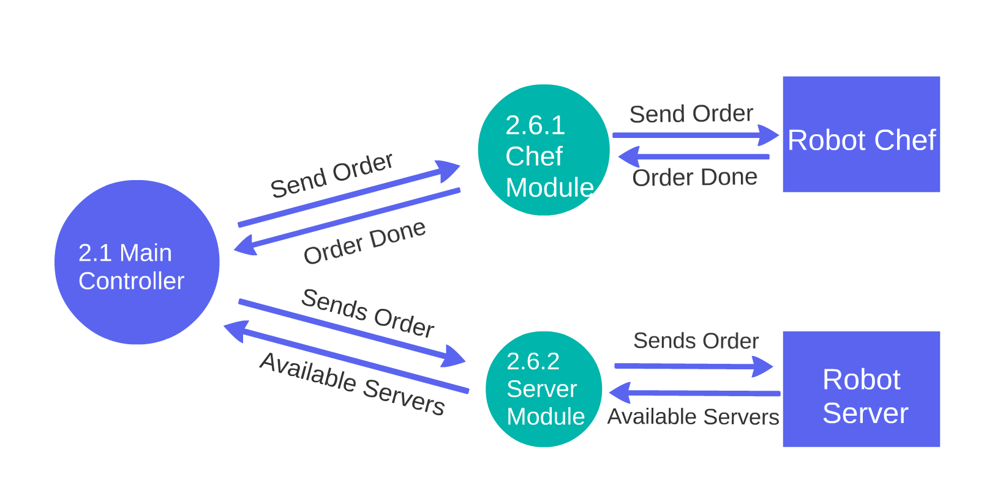
DFD 2.6: Kitchen Module

Slide 48
The Kitchen Control Module (KM) handles the cooking and serving aspects of the automated restaurant.
2.6 Kitchen Module
2.6 Kitchen Module
Notes:
The module will take approved orders (orders with confirmed payments) and will then distribute the information to the external Robot Chefs (RC) and external Robot Server (RS). It is noted that the RC and RS are both external devices and as such does not interact with the software much. The only data retrieved by the KM is when the RC has finished cooking their order and which RS are available to serve.

Slide 49
2.6 Kitchen Module
2.6.1 Chef Module
The MM shall send the order to the Chef Module (CM) that shall send the order to the RC.
2.6.2 Server Module
The Server Module(SM) shall tell the Robot Server (SM) to take the order and serve it to the customer.

Slide 50

